Slide 1
Postbac poster day

Slide 2
scRNA-seq
4-029. Daniel DeMelfi Genotyping of HLA Class I Genes with scRNAseq Data Using arcasHLA and UMI Consensus Lafayette College (Pennsylvania) Preceptor: Dr. Nan-Ping Weng
6-101. Laura Heinly Specificity of Neuronal Cell-Cell Communication using Single-Cell RNA Sequencing Data American University (District of Columbia) Preceptors: Dr. Stefano Marenco, Dr. Pavan Auluck
1-048. Divine Ayichi ScRNA-seq Analysis Reveals Drastic Epithelial Cell Transformation at the Climax of Xenopus Intestinal Metamorphosis University of Maryland College Park (Maryland) Preceptors: Dr. Yun-Bo Shi, Dr. Liezhen Fu
4-014. Samantha Hoge Using scRNA-seq to characterize cellular diversity in the highly regenerative flatworm Macrostomum lignano University of Georgia (Georgia) Preceptor: Dr. Erin Davies

Slide 3
scRNA-seq
5-022. Anisha Singhal Single Cell Transcriptomic Analysis of the Upper Airways of Children with Respiratory Virus Infections Rutgers University (New Jersey) Preceptors: Dr. Daniel Douek, Dr. Chaim Schramm

Slide 4
snRNAseq
6-102. Lauren Schramm snRNAseq Reveals Cell Type-Specific Expression Changes in the dlPFC in Schizophrenia George Washington University (District of Columbia) Preceptors: Dr. Pavan Auluck, Dr. Stefano Marenco
4-059. Monica Mesecar Multi-Region snRNA-Seq Analysis of Human Brain across Age Reveals Transcriptomic Patterns Conserved in Inhibitory Neurons University of Notre Dame (Indiana) Preceptors: Dr. Mark Cookson, Dr. Dominic Acr
6-078. Cordelia Hume Single-nucleus comparative transcriptomic perspective on the midline thalamus between the Rhesus Macaque, Common Marmoset, and Rat Duke University (North Carolina) Preceptor: Dr. Yogita Chudasama

Slide 5
RNAseq
4-117. Nasser Adjei RNA sequencing identified differentially expressed genes in the mesocorticolimbic and nigrostriatal system of rats with punishment associated compulsive and non-compulsive methamphetamine taking phenotypes George Washington University (District of Columbia) Preceptors: Dr. Jean Cadet, Dr. Atul Daiwile
4-107. James Ulysse Rna sequencing analysis identifies differentially expressed genes in the medial prefrontal of rats after continuous and intermittent access to sucrose Meharry Medical college (Maryland) Preceptors: Dr. Jean Cadet, Dr. Atul Dawile

Slide 6
Spatial transcriptomics
2-104. Sara Dawood Spatial Transcriptomics Reveals Changes in Tumor/Tumor Microenvironment During Neoadjuvant ADT in Locally Advanced Prostate Cancer University of Maryland (Maryland) Preceptor: Dr. Anson K
3-113. Hannah Odom Spatial Transcriptomics and its Application to the Mouse Cochlea Georgia Institute of Technology (Georgia) Preceptor: Dr. Ronna Hertzano
7-045. Nick Howell Investigating Glucagon-Deficient Endocrine Objects through Spatial Transcriptomics of Human Pancreas Arizona State University (Arizona) Preceptors: Dr. Mike Erdos, Dr. Leslie Biesecker
7-138. Junho Yi Characterization of Salivary Glands Virome in Sjogren's Syndrome Patients through the Use of Spatial Transcriptomics University of Maryland Baltimore County (Maryland)

Slide 7
Multi-omics/Transcriptomics
1-050. Elizabeth Davis Single Cell and Spatial Transcriptomics at the Molecular Genomics Core DePauw University (Indiana) Preceptors: Dr. Forbes Porter, Mr. Vivek Mahadevan
5-102. Nico Dellario A Transcriptomic Signature for Asthma Derived from PBMCs Rensselaer Polytechnic Institute (New York) Preceptors: Mr. Rakesh Natarajan, Dr. Rasika Mathias

Slide 8
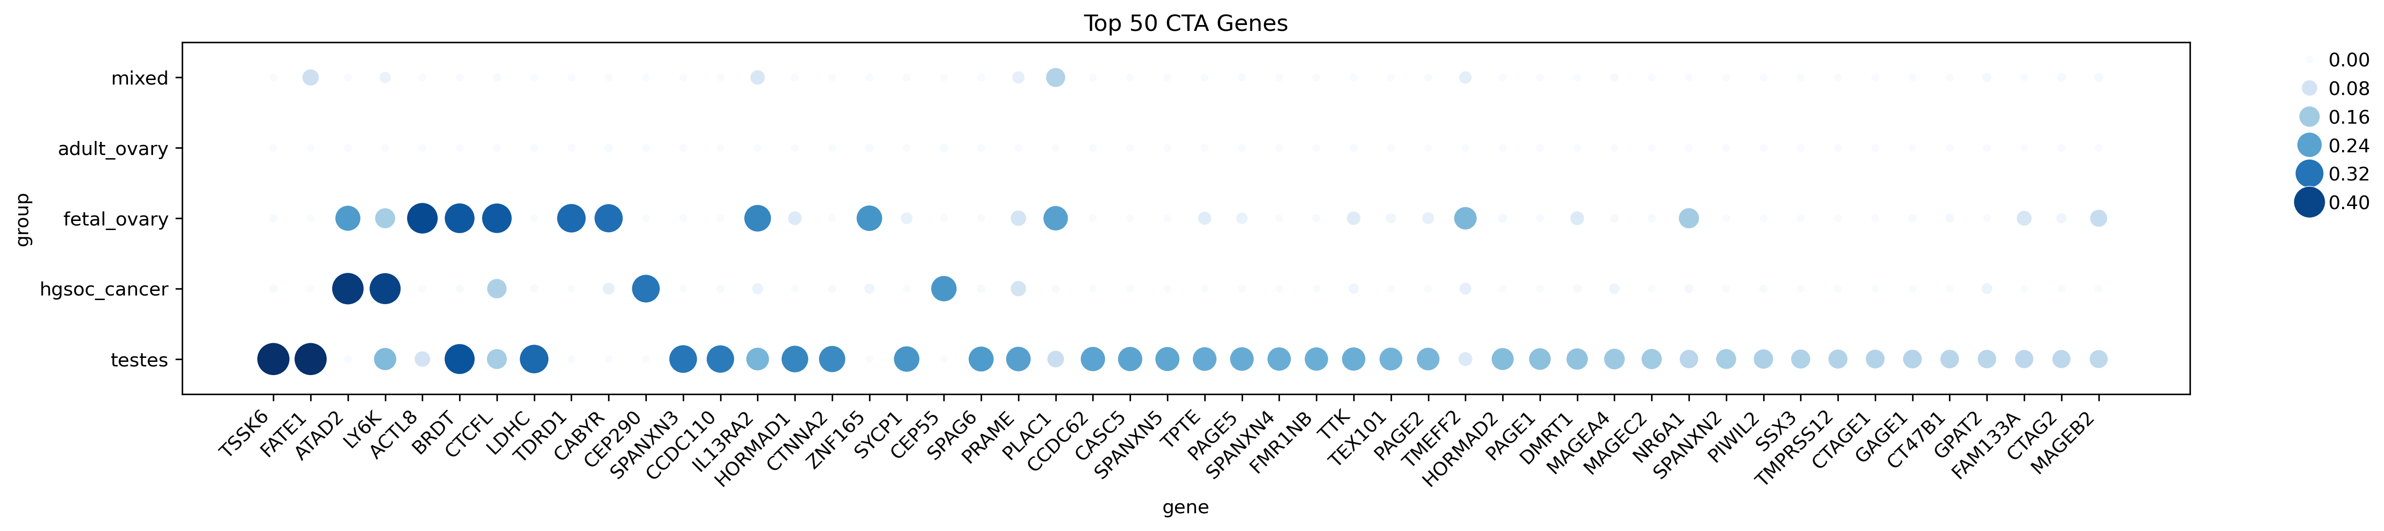
scRNA-Seq Reveals Unexpected Expression of Cancer-Testis Genes in Female Fetal Development
scRNA-Seq Reveals Cancer-Testis Antigen Expression in Fetal Development and Ovarian Cancer
scRNA-Seq Analysis Reveals Cancer-Testis Antigen Expression in Fetal and Ovarian Cancer Cells
Notes:
*Process, annotate scRNA-seq data of healthy ovary, healthy testis, fetal gonad, ovarian cancer (HGSOC)
*Cell types using cellmarker2.0, published atlases
*Published CTA list → quantify CTA expression for each dataset; compare across cell types in each dataset; compare across datasets
*Identify genes not activate in healthy ovary that are CTA, that are active in fetal, cancer and fetal + cancer (oncofetal reprogramming)

Slide 9
Poster technical requirements
Poster Board Size: 72" (Width) x 48" (Height)
Recommended Poster Size: 48” (Width) and 36” (Height)
Poster Orientation: Landscape
Recommended Font Sizes:
Title: 80 pt
Section Headings: 54 pt
Secondary Section Headings or Figure Title: 44 pt
General Text: 36 – 40 pt
Figure/table legends: 28 pt
Content and design
Content
Include the following components in your poster presentation:
Title and Author Information:
Title
Author, Affiliation
Institute or Center name, logos
Content:
an introduction (providing background information),
a brief statement of the purpose of the project,
a description of materials and methods used, and
a summary of results and conclusions.
Design
Here are some general guidelines for laying out the design of your poster:
A light background with dark text is easiest to read.
Use one font and style to integrate all portions of your poster.
Label graphics directly and use tables for small data sets.
Keep your title simple and consider using it to state the conclusion or focus of your study.
Figures, diagrams, and bullet points are better than paragraphs of text.
A general rule of thumb is to allow 40% of your space for graphics, 20% for text, and 40% for white space.

Slide 10
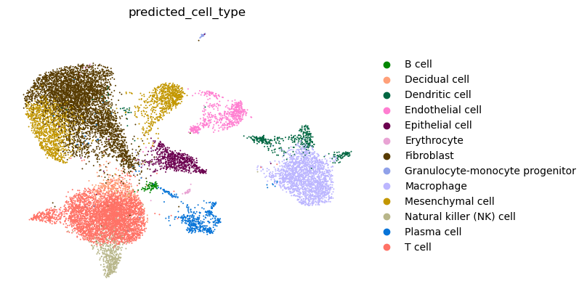
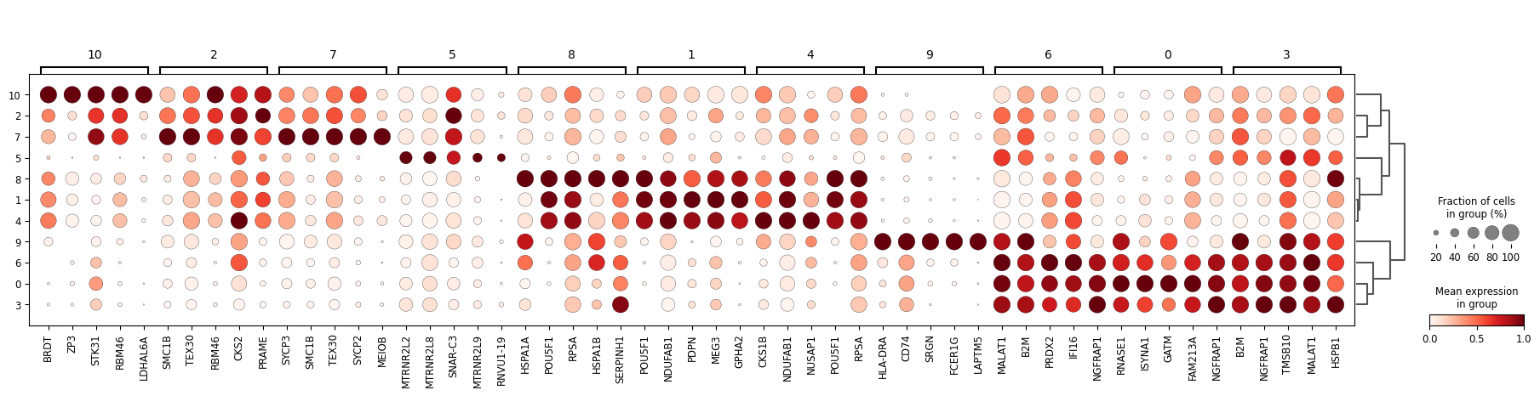
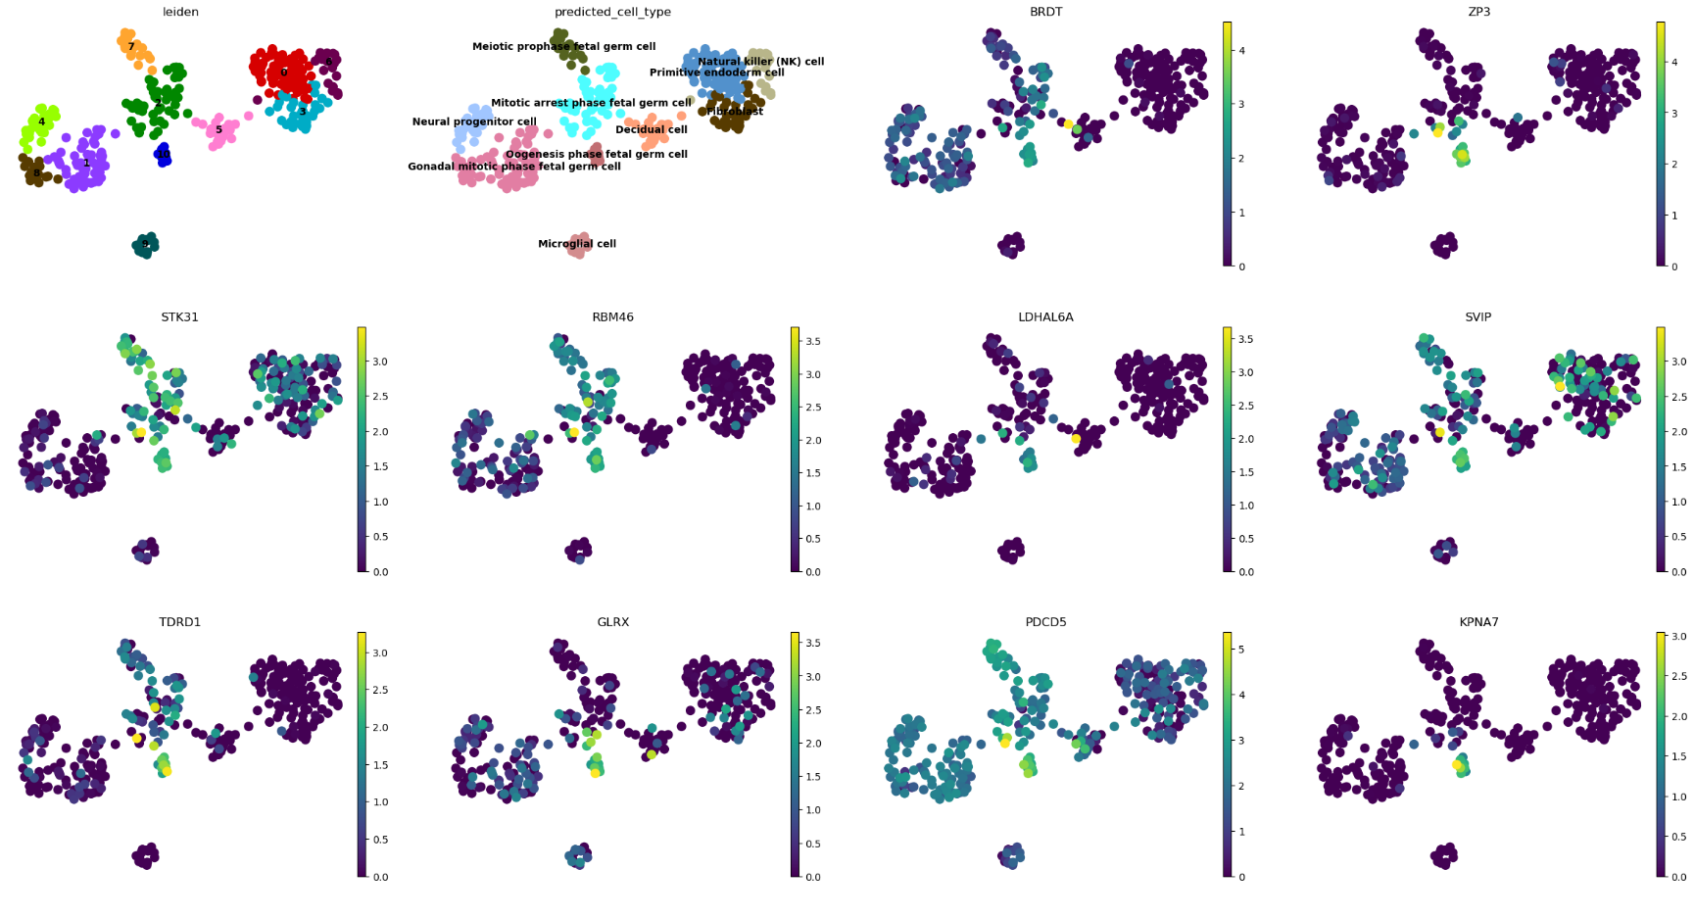
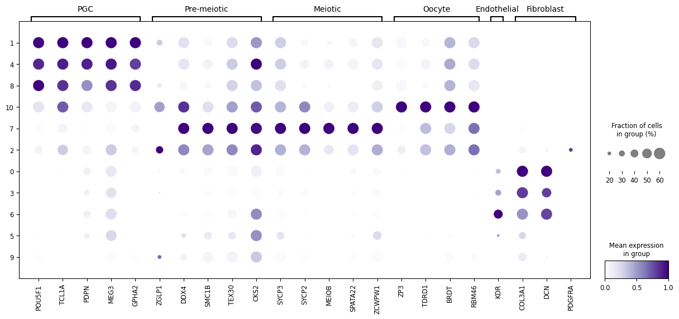
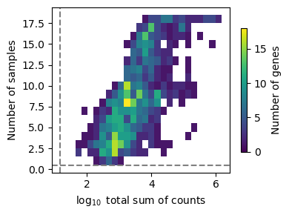
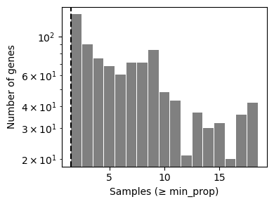
scRNA-Seq Reveals Unexpected Expression of Cancer-Testis Genes in Female Fetal Development
Introduction
UMAP of cell types
Ovarian cancer dotplot
Cancer-testes genes (CTGs refer to genes that are expressed only in germ cells under normal physiological conditions, that may be reactivated during tumorigenesis, making them good candidates for oncogenes¹
The gene products of CTGs are referred to as cancer-testis antigens (CTAs) and they may be good candidates for therapy due to their restricted expression in normal tissues and their immunogenicity¹
A number of CTGs are known to be aberrantly expressed in ovarian cancer, including AKAP3, AKAP4, BAGE, CTCFL, CT45, GAGE1/2, HOM-TES-85, HORMAD1, HSP70-2, LAGE-1, MAGE-A1, MAGE-A2, MAGE-A3, MAGE-A9, MAGE-A10, MAGE-C1, NY-ESO-1, OY-TES-1, PRAME, PASD1, PIWIL2, PIWIL3, PIWIL4, PLU-1, PLAC1, SPAG9, SCP-1, SP17, SSX2, SSX1, SSX4, TAG-1, TAG-2a, TAG-2b, TAG2c, TRAG-3²
UMAP of CTG expression
Conclusions
CTGs are expressed, in various levels, across the different stages of female fetal development, showing they are a normal part of a developmental gene program
Expression patterns are consistent with proliferativeative states
These findings could indicate that CTG expression in certain cancers such as ovarian cancer may be a reactivation of these fetal development programs, rather than a random, abberant gene reactivation
Hypothesis
CTGs are transiently expressed in specific cell populations during female fetal development
Methods
Publicly available scRNAseq datasets were obtained from GEO (GSE86146, GSE181558) containing male and female embryonic cells and fetal cells, from both first and second trimester
The data was processed with Scanpy. Cells were filtered based on gene counts, total counts and mitochondrial content. The data was normalized, log-transformed and highly variable genes were identified. PCA, UMAP and Leiden clustering were used for dimensionality reduction and cell population identification
The database CellMarker2.0 and known marker genes were used to annotate and refine cell type annotations
Dotplot summary
Future Work
Use multitomoic data to investigate epigentic regulation of CTGs in both fetal and tumor development
Extent analysis to include additional fetal development data and cancer data
Determine the biological role of CTGs in fetal cell proliferation and differentiation
Expand to other species to cmpare evolutionary conservation of CTGs in fetal development o tumorigenessis progras
Acknowledgements
QC plot
Notes:
[1] https://www.nature.com/articles/ncomms10499
[2] https://pmc.ncbi.nlm.nih.gov/articles/PMC6318940/

Slide 11
